Slide 1
Water & Air Pollution https://www.youtube.com/watch?v=BCHhwxvQqxg&feature=player_detailpage

Slide 2
Water Resources
Over the last century:
  Human population has increased 3x
  Global water withdrawal has increased 7x
  Per capita water withdrawal has increased 4x
  About one-sixth of the world’s people don’t have easy access to safe water

Slide 3
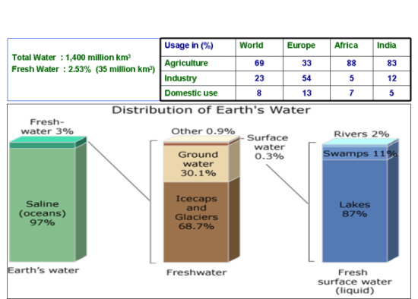
Global Water Availability

Slide 4
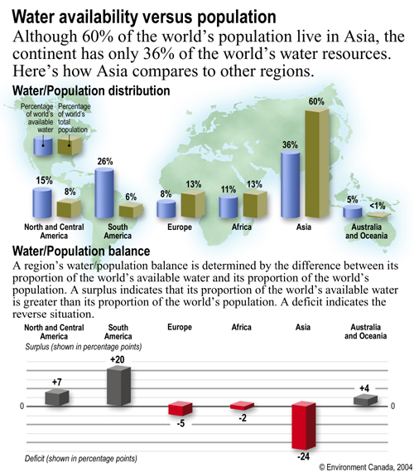

Slide 5
Recommended basic water requirements
 | Water requirements (litres per capita per day)
Drinking water | 5
Sanitation services | 20
Bathing | 15
Food preparation | 10

Slide 6
Water Pollution Facts
Rivers in the continent of Asia are considered to be the most polluted. These rivers contain 20 times as much lead found in water bodies of the industrialized countries of other continents.
The bacteria (from human waste) found in these rivers are 3 times as much as that of the global average.
Contamination of groundwater is a major problem in Bangladesh. One of the major pollutants which affect water quality in this country is arsenic.
Around 85% of the total area of Bangladesh has contaminated groundwater. It means that, over 1.2 million citizens of this nation are exposed to the hazardous effects of arsenic-contaminated water.

Slide 7
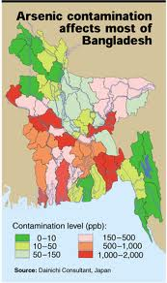
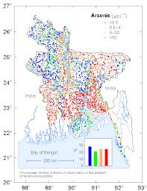

Slide 8
Water Pollution Facts……
According to the data compiled by the World Water Assessment Program (WWAP), 2 million tons of human waste is disposed in water bodies every single day. The developing countries have a major share in water pollution, as 70% of the industrial waste which is dumped untreated in the water bodies comes from these developing countries of the world.
A study carried out in the 49 states of the US revealed that nitrate was the principal contaminant of groundwater in this region. Along side groundwater, agriculture also plays a significant role in the pollution of larger water bodies in the form of surface run off.

Slide 9
WATER POLLUTION
Ideal water supply
  Quality
  Quantity
Water quality parameter
  Physical
    Suspended solid (SS), color, taste, smell, temp.
  Chemical
    Dissolved substances, alkalinity, hardness, fluoride, heavy metal, organic compound, nutrient (nitrogen & phosphorus), pH, biochemical oxygen demand (BOD).
  Biological
    Bacteria, virus, protozoa, helminthes.

Slide 10
4 types of water pollutants:
Toxic
Chemicals that kill organisms
Examples: Pesticides and herbicides, gasoline, oil, household cleaning products, paints and solvents, battery fluid, industrial waste and DDT..
Sediment
Dirt, minerals, sand and silt eroded from land and washed into the water;
Reduces sunlight that can reach plants which provide food to underwater animals

Slide 11
4 types of water pollutants ……
Nutrient
Too much nitrogen and phosphorous;
Causes too much algae growth which clouds water and limits sunlight from reaching plants;
Causes by sewage plant overflow, leakage from septic tanks, factory discharge, fertilizers and animal manure.
Bacterial
Too much bacteria in the water;
Sources are sewage treatment facilities, leakage in septic tanks and animal manure.

Slide 12
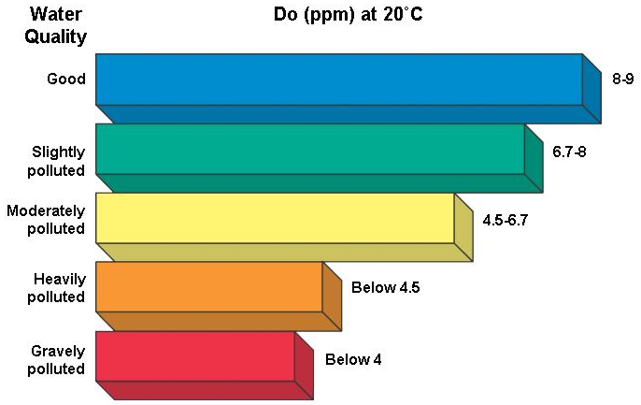
Sources of Water Pollution
Point sources
Nonpoint sources
Water quality

Slide 13
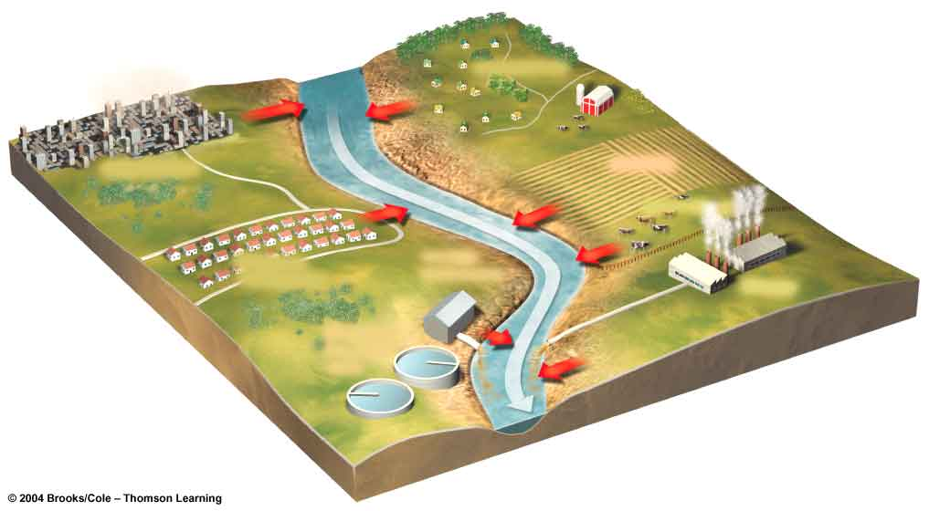
Point and Non-point Sources
NONPOINT SOURCES
Rural homes
Urban streets
Cropland
Animal feedlot
Suburban development
POINT SOURCES
Factory
Wastewater treatment plant
Fig. 22-4 p. 494

Slide 14
Pollution Sources
Point sources are direct discharges to a single point;
  examples include discharges from sewage treatment plants, injection wells, and some industrial sources.
Non-point sources are diffused across a broad area and their contamination cannot be traced to a single discharge point.
  Examples include runoff of excess fertilizers, herbicides, and insecticides from agricultural lands and residential areas; oil, grease, and toxic chemicals from urban runoff and energy production.

Slide 15
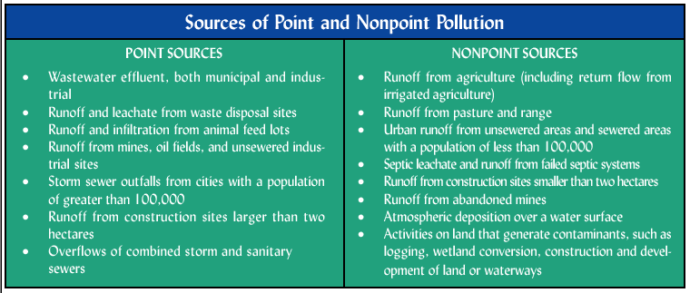
Notes:
Sources of point and nonpoint chemical inputs to lakes, rivers, and oceans recognized by statutes.
Pollutant discharges from point sources tend to be continuous and therefore relatively simple to identify and monitor.
Nonpoint sources, however, arise from a suite of activities across large areas and are much more difficult to control.
Issues in Ecology Number 3 Summer 1998
Nonpoint Pollution of Surface Waters with Phosphorus and Nitrogen

Slide 16
How do we know when water is polluted?
There are two main ways of measuring the quality of water. One is to take samples of the water and measure the concentrations of different chemicals that it contains. If the chemicals are dangerous or the concentrations are too great, we can regard the water as polluted. Measurements like this are known as chemical indicators of water quality.
Another way to measure water quality involves examining the fish, insects, and other invertebrates that the water will support. If many different types of creatures can live in a river, the quality is likely to be very good; if the river supports no fish life at all, the quality is obviously much poorer. Measurements like this are called biological indicators of water quality.

Slide 17
Water pollution: Sources
INDUSTRY
Industry is a huge source of water pollution, it produces pollutants that are extremely harmful to people and the environment.
Pollutants from industrial sources include:
  Asbestos – This pollutant is a serious health hazard. Asbestos fibers can be inhaled and cause illnesses such as asbestosis, lung cancer, intestinal cancer and liver cancer.
  Lead – This is a metallic element and can cause health and environmental problems. Lead is harmful to the health of many animals, including humans, as it can inhibit the action of bodily enzymes.

Slide 18
2) Oil pollution in water
Oceans are polluted by oil on a daily basis from oil spills, routine shipping, run-offs and dumping.
Oil spills make up about 12% of the oil that enters the ocean. The rest come from shipping travel, drains and dumping.
Oil spills cause a very localised problem but can be catastrophic to local marine wildlife such as fish, birds and sea otters.
Oil cannot dissolve in water and forms a thick sludge in the water. This suffocates fish, gets caught in the feathers of marine birds stopping them from flying and blocks light from photosynthetic aquatic plants.

Slide 19
3) Radio Active Waste
Nuclear waste is produced from industrial, medical and scientific processes that use radioactive material. Nuclear waste can have detrimental effects on marine habitats. Nuclear waste comes from a number of sources:
Operations conducted by nuclear power stations produce radioactive waste. Nuclear-fuel reprocessing plants in northern Europe are the biggest sources of man-made nuclear waste in the surrounding ocean. Radioactive traces from these plants have been found as far away as Greenland.
Mining and refining of uranium and thorium are also causes of marine nuclear waste.

Slide 20
Harms of Water Pollution
Virtually all types of water pollution are harmful to the health of humans, animals, and environment. Water pollution may not damage our health immediately but can be harmful after long term exposure.
Different forms of pollutants affect the health of animals in different ways:
Heavy metals from industrial processes can accumulate in nearby lakes and rivers. These are toxic to marine life such as fish and shellfish, and subsequently to the humans who eat them.

Slide 21
Harms of Water Pollution….
Industrial waste often contains many toxic compounds that damage the health of aquatic animals and those who eat them. Some of the toxins in industrial waste may only have a mild effect whereas other can be fatal. They can cause immune suppression, acute poisoning.
Microbial pollutants from sewage often result in infectious diseases that infect aquatic life and terrestrial life through drinking water. Microbial water pollution is a major problem in the developing world, with diseases such as cholera and typhoid fever being the primary cause of infant mortality.

Slide 22
Harms of Water Pollution….
Organic matter and nutrients causes an increase in aerobic algae and depletes oxygen from the water column. This causes the suffocation of fish and other aquatic organisms.
Sulfate particles from acid rain can cause harm the health of marine life in the rivers and lakes it contaminates, and can result in mortality.
Suspended particles in freshwater reduces the quality of drinking water for humans and the aquatic environment for marine life. Suspended particles can often reduce the amount of sunlight penetrating the water, disrupting the growth of photosynthetic plants and micro-organisms.

Slide 23
Prevention
If you want to help keep our water clean, there are many things you can do to help:
Conserve water by turning off the tap when running water is not necessary. This helps prevent water shortages and reduces the amount f contaminated water that needs treatment.
Be careful about what you throw down your sink or toilet. Don't throw paints, oils or other forms of litter down the drain.
Use environment friendly household products, such as washing powder, household cleaning agents and toiletries.

Slide 24
Prevention……
Take great care not to overuse pesticides and fertilizers. This will prevent runoffs of the material into nearby water sources.
By having more plants in your garden you are preventing fertiliser, pesticides and contaminated water from running off into nearby water sources.
Don't throw litter into rivers, lakes or oceans. Help clean up any litter you see on beaches or in rivers and lakes, make sure it is safe to collect the litter and put it in a nearby dustbin.

Slide 25
Scarce of drinking water
This natural resource is becoming scarcer in certain places, and its availability is a major social and economic concern. Currently, about a billion people around the world routinely drink unhealthy water.
Most countries accepted the goal of halving by 2015 the number of people worldwide who do not have access to safe water and sanitation during the 2003 G8 Evian summit.
Even if the difficult goal is met, it will still leave more than an estimated half a billion people without access to safe drinking water and over a billion without access to adequate sanitation.

Slide 26
Scarce of drinking water……
Poor water quality and bad sanitation are deadly; some five million deaths a year are caused by polluted drinking water.
The World Health Organization estimates that safe water could prevent 1.4 million child deaths from diarrhea each year.
It is, rather, the distribution of potable and irrigation water which is scarce, than the actual amount of it that exists on the earth.

Slide 27
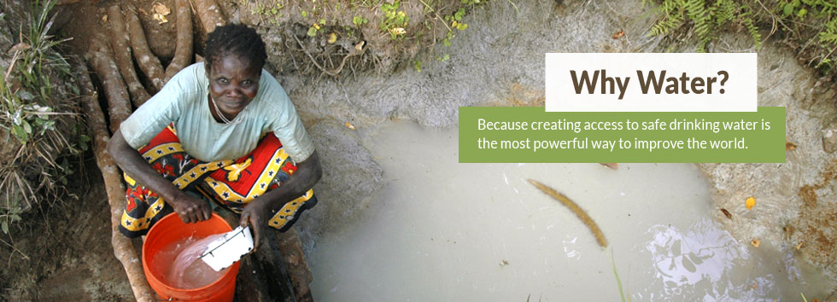
https://www.youtube.com/watch?feature=player_embedded&v=BCHhwxvQqxg

Slide 28
Air Pollution

Slide 29
Air Pollution
An air pollutant is known as a substance in the air that can cause harm to humans and the environment. Pollutants can be in the form of solid particles, liquid droplets, or gases. In addition, they may be natural or man-made.
Air pollution is the introduction of chemicals, particulate matter, or biological materials that cause harm or discomfort to humans or other living organisms, or damages the natural environment into the atmosphere.
Indoor air pollution and urban air quality are listed as two of the world's worst pollution problems in the 2008 Blacksmith Institute World's Worst Polluted Places report.

Slide 30
Air Pollution
Pollutants can be classified as either primary or secondary. Usually, primary pollutants are substances directly emitted from a process, such as ash from a volcanic eruption, the carbon monoxide gas from a motor vehicle exhaust or sulfur dioxide released from factories.
Secondary pollutants are not emitted directly. Rather, they form in the air when primary pollutants react or interact. An important example of a secondary pollutant is ground level ozone — one of the many secondary pollutants that make up photochemical smog.

Slide 31
Major primary pollutants produced by human activity
Sulfur oxides (SOx) - especially sulfur dioxide
Nitrogen oxides (NOx) - especially nitrogen dioxide are emitted from high temperature combustion.
Carbon monoxide - is a colourless, odourless, non-irritating but very poisonous gas.
Carbon dioxide (CO2) - a greenhouse gas
Volatile organic compounds - VOCs are an important outdoor air pollutant
Particulate matter - Particulates, alternatively referred to as particulate matter (PM) or fine particles, are tiny particles of solid or liquid suspended in a gas.

Slide 32
Major primary pollutants produced by human activity….
Toxic metals, such as lead, cadmium and copper
Chlorofluorocarbons (CFCs) - harmful to the ozone layer
Ammonia (NH₃) - emitted from agricultural processes
Odors — such as from garbage, sewage, and industrial processes
Radioactive pollutants - produced by nuclear explosions, war explosives, and natural processes such as the radioactive decay of radon.

Slide 33
Effects of Air Pollution
Air pollution is responsible for major health effects. Every year, the health of countless people is ruined or endangered by air pollution.
Studies have estimated that the number of people killed annually in the US alone could be over 50,000.
Older people are highly vulnerable to diseases induced by air pollution. Children and infants are also at serious risk.
Air pollutants such as ozone, nitrogen oxides, and sulfur dioxide have harmful effects on natural ecosystems.

Slide 34
Effects of Air Pollution……
Acid rain (a product of air pollution) severely affects trees and plants as well.
It can kill trees, destroy the leaves of plants, can infiltrate soil by making it unsuitable for purposes of nutrition and habitation.
It is also associated with the reduction in forest and agricultural yields.

Slide 35
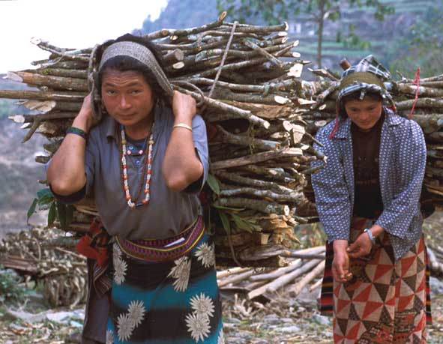
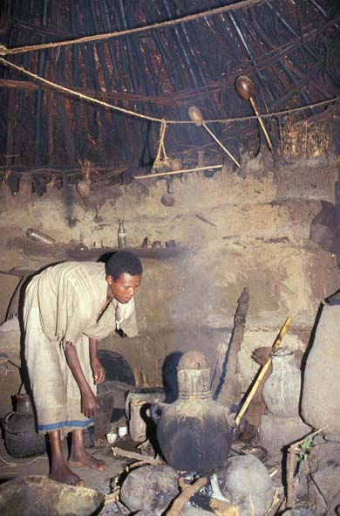
Smoke in the Kitchen
Health Impacts of
Indoor Air Pollution
in Developing Countries

Slide 36
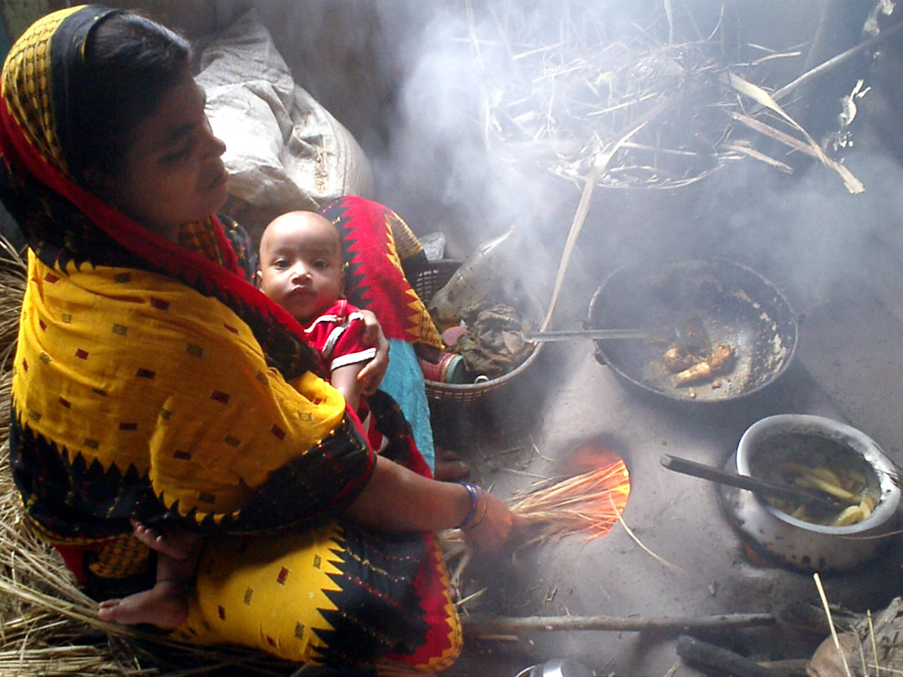

Slide 37
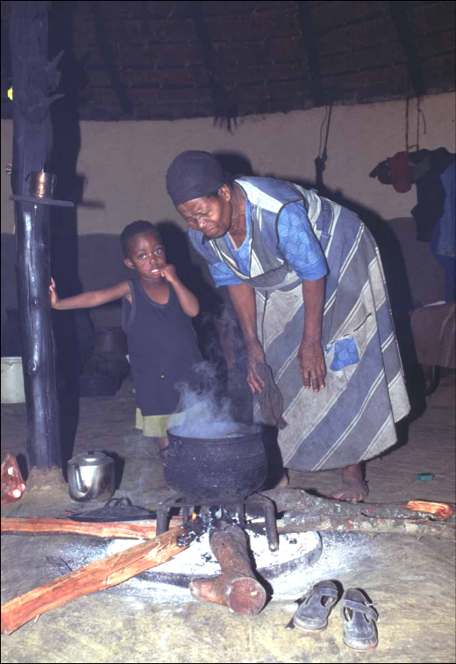
Household energy,
indoor air pollution and health
Some 3 billion people rely on solid fuels (e.g. dung, wood, agricultural residues, charcoal, coal) for their basic energy needs.
Cooking and heating with solid fuels leads to high levels of indoor air pollution (IAP), a complex mix of health-damaging pollutants (e.g. PM, CO).
Women and young children, who spend most time at home, experience the largest exposures and health burdens.

Slide 38
Possible Solutions
For urban areas
For rural areas
For Industries

Slide 39
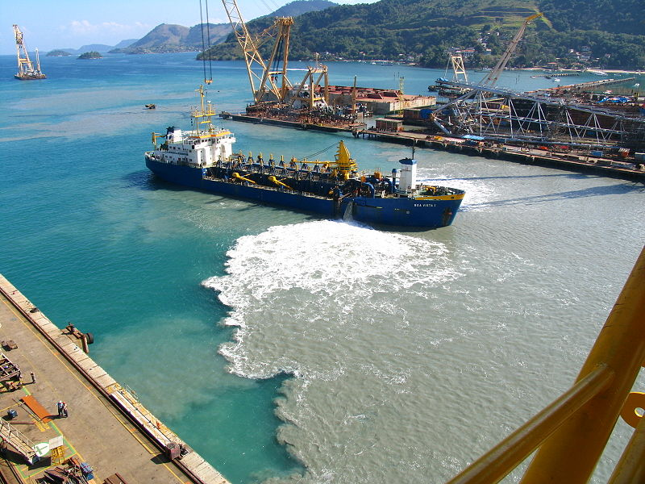
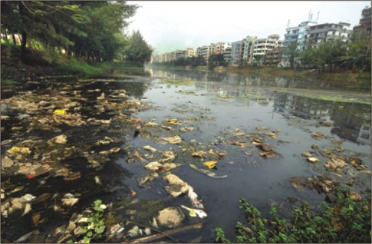

Slide 40
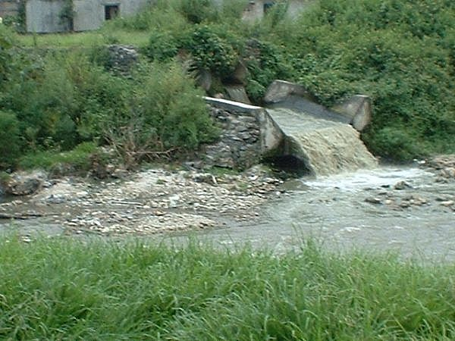
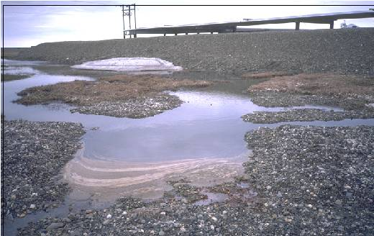

Slide 41
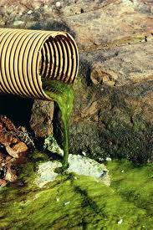
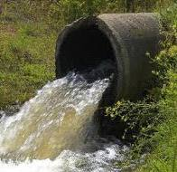
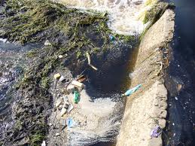
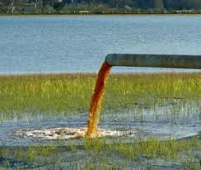
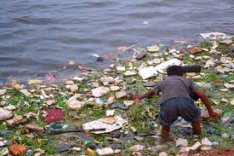
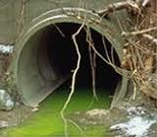
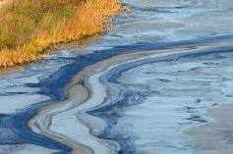

Slide 42
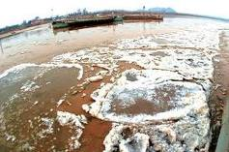
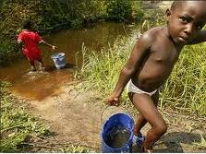
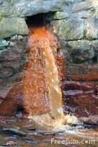
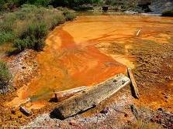
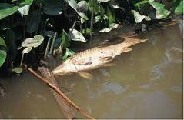
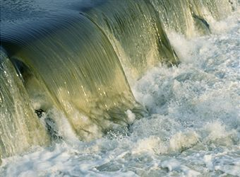
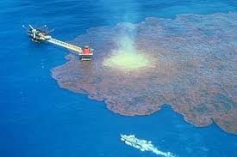

Slide 43
